Slide 1
Creating a Bulletin Board System
Dylan, Artjom, and Sue

Slide 2
What we based our project on
Based on Stackoverflow
BBS system designed around questions and answers
Free to use
Has an upvote and downvote system
Can add tags to questions

Slide 3
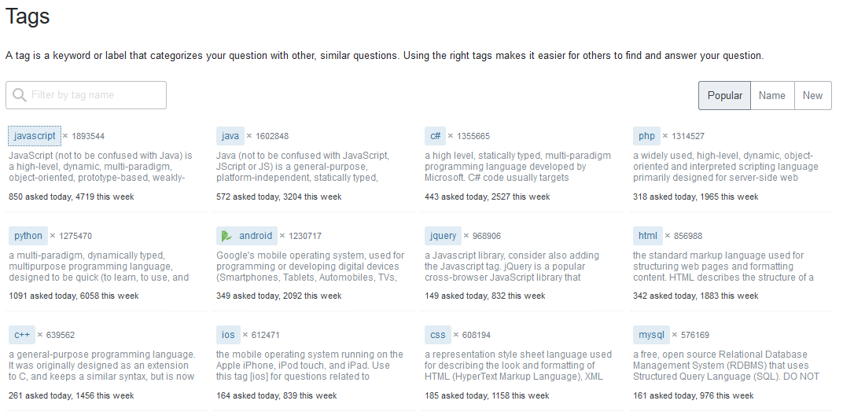

Slide 4
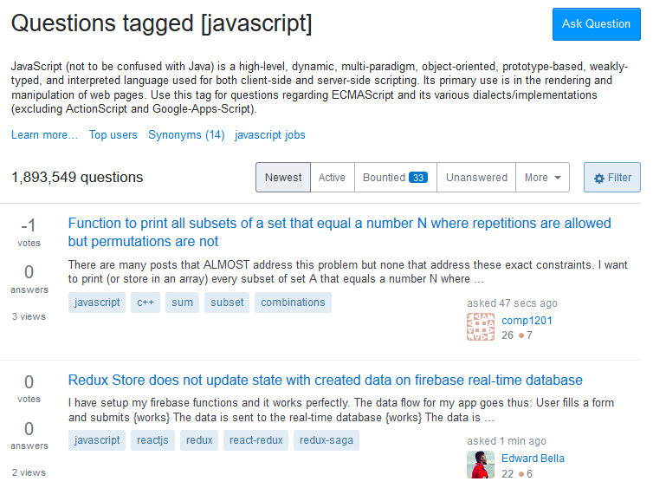

Slide 5
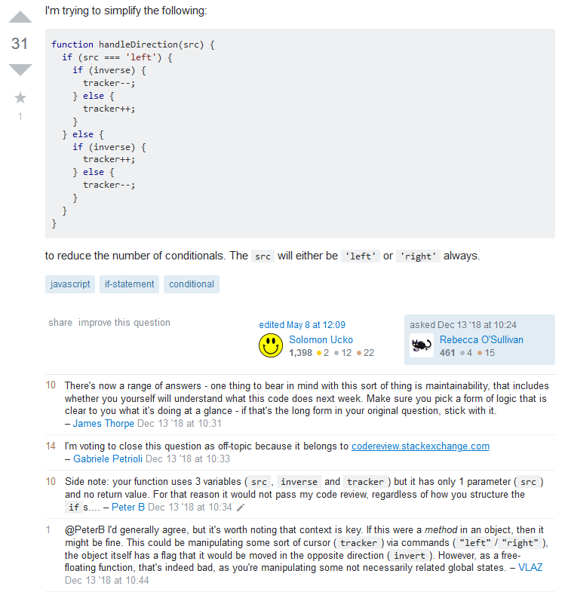
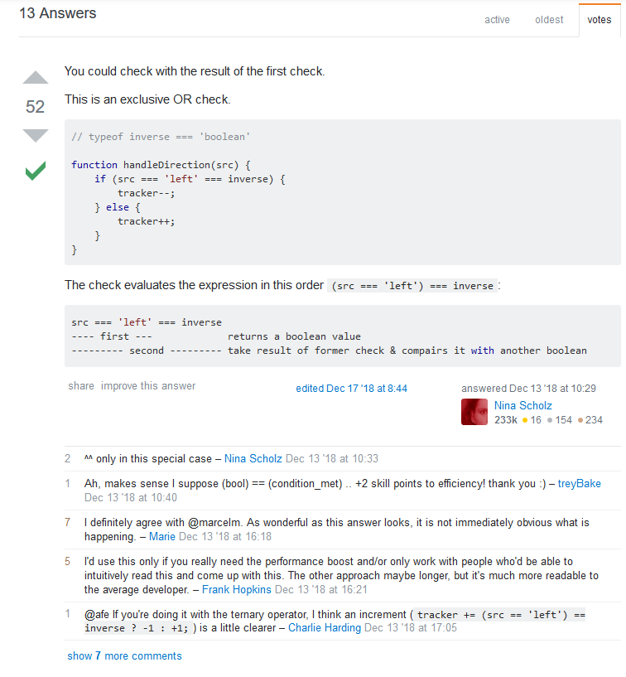

Slide 6
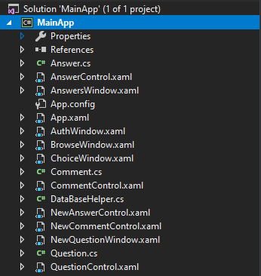
Summary of the Project
Hardest part was the programming
Had 10 WPF forms and 4 classes
Needed to link everything together in code and in the SQL database
Major change was to drop the tags concept
If we did the project again we’d take more time on the GUI, WPF forms, and more functionality
https://github.com/qniff/system-docs

